Slide 1
Warm Up
Determine whether the substance is homogeneous, heterogeneous, element or compound.
Water
Chocolate chip brownie
Old milk
Smoke
Ocean water
Salt
Dry ice
Mineral Water
Diamond
Sand

Slide 2
Chemistry
Chemistry is the study of the composition, structure, and properties of matter, the processes that matter undergoes, and the energy changes that accompany these processes.
What a mouth full.

Slide 3
Chemistry
There are six basic parts of chemistry
1. Organic - the study of most carbon-containing compounds.
2. Inorganic – the study of all other compounds usually metallic based.
3. Physical – The study of properties and changes of matter related to energy.
4. Analytical – The identification of components and composition of materials.
5. Biochemistry – The study of matter in living things
6. Theoretical – Using math and computers to help understand the principals behind observed properties and behaviors and predict new behaviors.

Slide 4
Matter
Matter is anything that has mass and takes up space. (volume)
What is mass?
Mass is the measure of how much of the substance there is. Scales tell you mass.

Slide 5
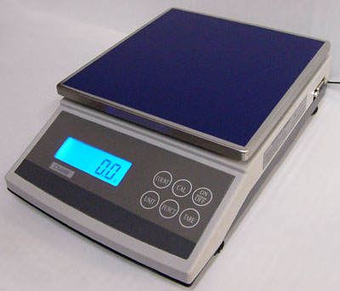
Matter
Is air matter? How can you put air on a scale? Lets see.

Slide 6
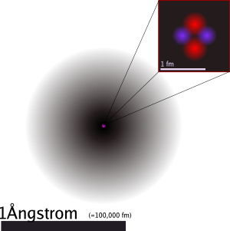
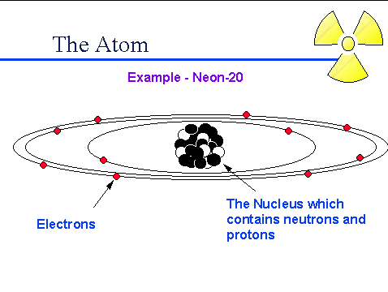
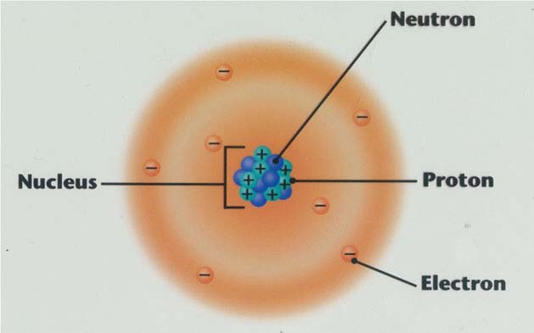
Matter
What makes up matter?
The atom. The atom is the smallest unit of matter.

Slide 7
Atoms
Atoms are the simplest form of matter.
There are quite a number of different atoms.
Almost 118 to be exact. These are known as are elements.

Slide 8
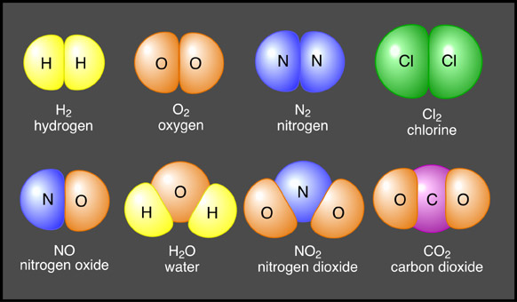
Atoms
Atoms of different elements combine and BOND to form compounds.

Slide 9
Atoms
Elements and compounds stand alone as pure substances.
When elements and compounds are present together but not bonded you have a mixture.

Slide 10
Mixtures
We have two types of mixtures heterogeneous and homogenous.
Hetero – not uniform, different
homo – uniform, the same.

Slide 11
Properties of Matter
Extensive Properties – changes with the amount of matter you have.
Intensive Properties – does not matter how much you have.
Ex. Volume, mass, amount of energy
Ex. Density, boiling point, melting point, conduct electricity and heat

Slide 12
Properties of Matter
We have two types of properties. Chemical and Physical.

Slide 13
Physical change involves altering the physical characteristics of a substance.
We do not change the substance.
The substance only takes on a new form.

Slide 14
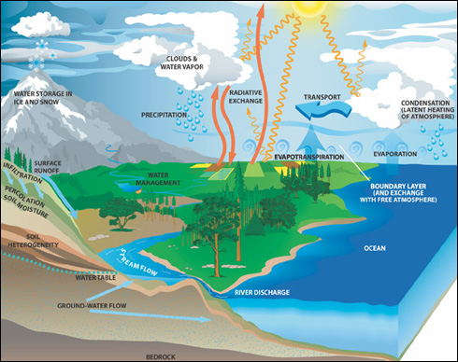
Example Water:
Water can be ice (solid phase) then melt to water (liquid) then evaporate (gas).
The substance is still water. H₂O

Slide 15

Chapter 1
Section 2 Matter and Its Properties
Physical Properties and Physical Changes, continued
A change of state is a physical change of a substance from one state to another.
states of matter—solid state, liquid state, gas state, plasma
In the solid state, matter has definite volume and definite shape.
In the liquid state, matter has a definite volume but an indefinite shape.

Slide 16
Chapter 1
Section 2 Matter and Its Properties
Physical Properties and Physical Changes, continued
In the gas state, matter has neither definite volume nor definite shape.
Plasma is a high-temperature physical state of matter in which atoms lose most of their electrons, particles that make up atoms.

Slide 17
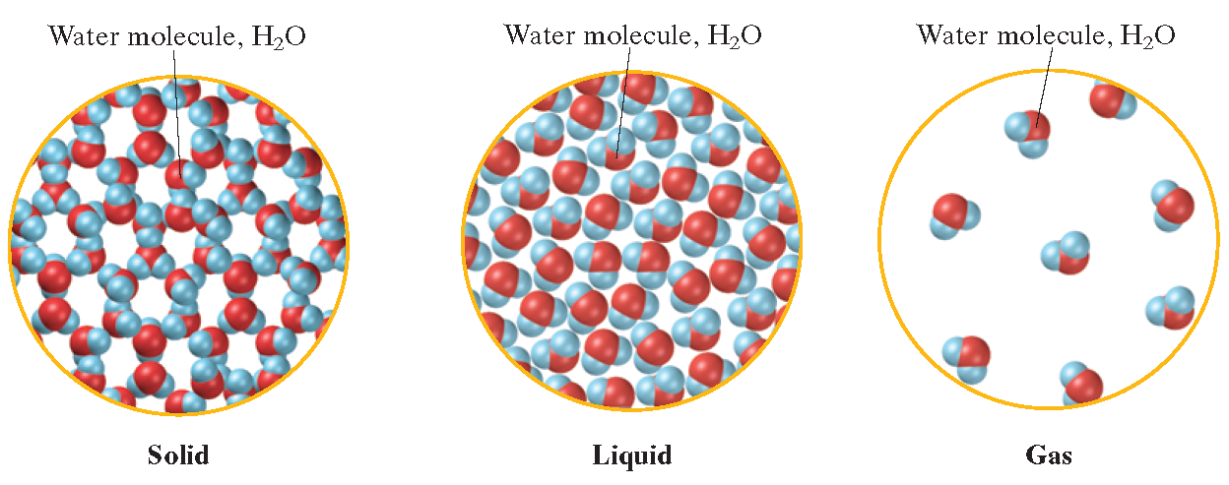
Chapter 1
Water in Three States

Slide 18
A chemical change involves a change in chemical make up of the substance.
The substances go through a chemical reaction.
Your starting substance (reactants) have a new chemical composition (products)

Slide 19
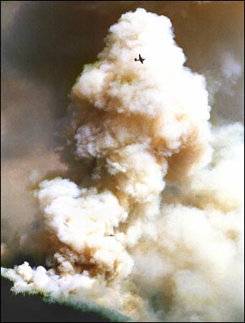
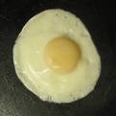
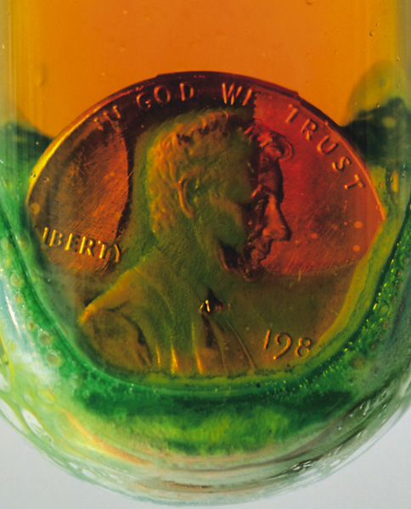
Signs of a chemical reaction:
Gas released, color change, smoke, temperature change, smells, and not easily reversible.

Slide 20
You can write a chemical equation.
CH₃COOH+Na₂CO₃--> NaCH₃COO+CO₂+H₂O
Reactants – Substances at the start of the reaction (react)
Products – Substances that are formed in the end of the reaction. (produced)

Slide 21
The Elements
Introduction
Vocabulary:
Groups or Families
Periods
Metals
Non Metals
Metalloid

Slide 22
Metals
Found on the left side of the staircase on the periodic table. Really???
Metals have metallic luster. (shiny)
Metals conduct electricity (electricity passes through them) and are good heat conductors.
Metals are solids at room temperature (except Mercury) and are Malleable (can be shaped and molded) and Ductile (pulled into wires).
Some metals can be hard and dense and not easily shaped unless in the presence of a large amount of energy.
There are quite a few metals that are Magnetic.

Slide 23
Nonmetals
Found on the right side of the staircase on the periodic table.
Nonmetals include gases.
Bromine is the lone liquid nonmetal.
The solid non metals are poor conductors of heat and electricity. They are also quite brittle.
Not malleable, ductile, magnetic, opposite of metals

Slide 24
Metalloids
Found on either side of the staircase of the PT.
There are six metalloids (according to our book) found on the PT.
Silicon (Si), Germanium (Ge), Arsenic (As), Antimony (Sb) and Tellurium (Te)
They share properties of both metals and nonmetals.
Some dispute over number of Metalloids

Slide 25
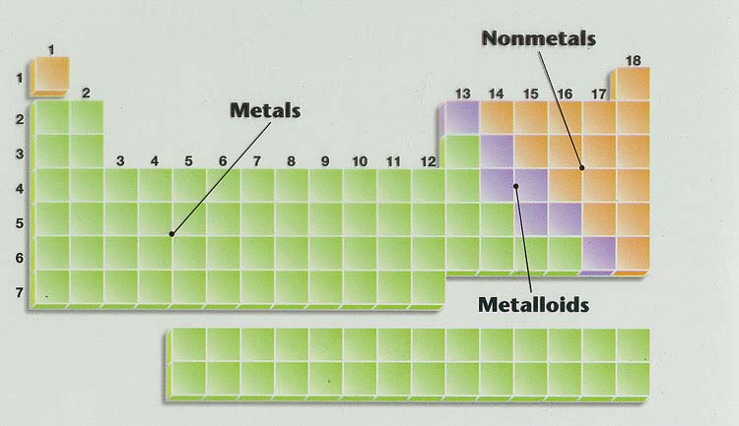
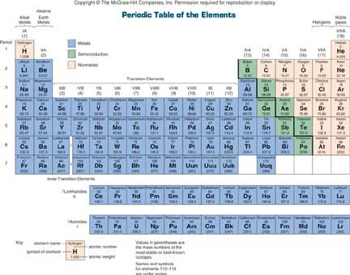
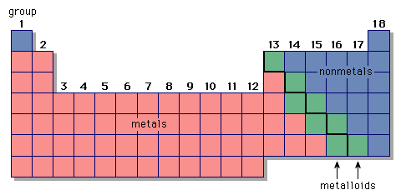

Slide 26
Separation of a Mixture
You will exam a mixture of Iron, Salt (NaCl), Sand and Plastic Beads.
With the persons next to you, discuss a way to separate all of these substance based on their physical properties.

Slide 27
Separation of a Mixture
PRE LAB
You will write on loose leaf paper (or graph paper) the pre lab write up to keep in your notebook.
Come up with your own unique purpose.
Identify at least 5 safety rules that we will think about for this lab.
Create a data table

Slide 28
Separation of a Mixture
Create a Schematic Procedure
Set up the lab ready for lab work. No Chairs at lab stations (chairs outside or at tables, not lab tables). No bags, binders at lab stations. All aisles clear.
Create detailed diagrams on butcher paper using only illustrations, diagrams and color.
Detailed means a child could understand the lab just by following your pictures.
Another group member will investigate lab tubs. Find your lab tub under the sink. Your lab tub is labeled and numbered.
Pull out the materials you will need for the lab and place them on your work space. GET STAMPED!
You do not have a magnet, weigh boat or Ziploc bag.
We will Clean Up the last five minutes of class

